Slide 1
Java EE
The platform provides an API and runtime environment for developing and running enterprise software, including network and web services, and other large-scale, multi-tiered, scalable, reliable, and secure network applications.

Slide 2
Java EE
Java EE, strictly speaking, is a set of APIs (as the current top answer has it) which enable a programmer to build distributed, transactional systems. The idea was to abstract away the complicated distributed, transactional bits (which would be implemented by a Container such as WebSphere or Weblogic), leaving the programmer to develop business logic free from worries about storage mechanisms and synchronization.

Slide 3
Java EE
Java EE is developed under the Java Community Process.

Slide 4
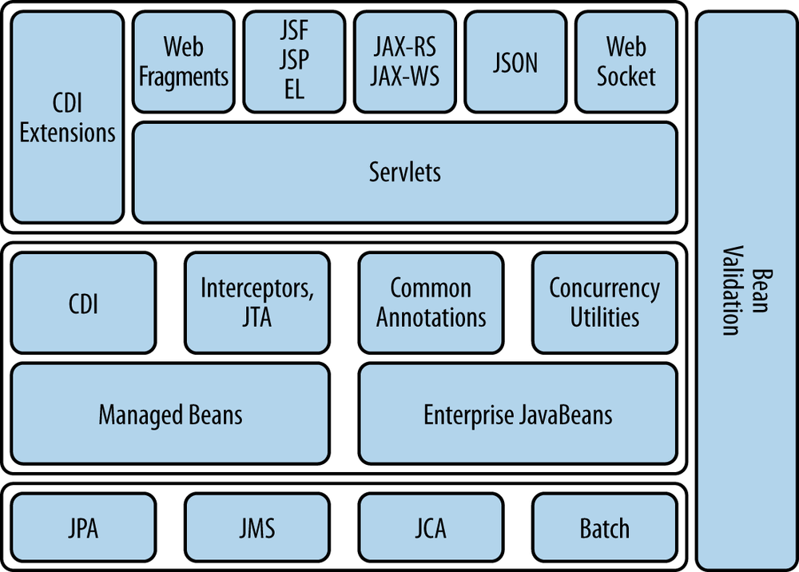
Java EE

Slide 5
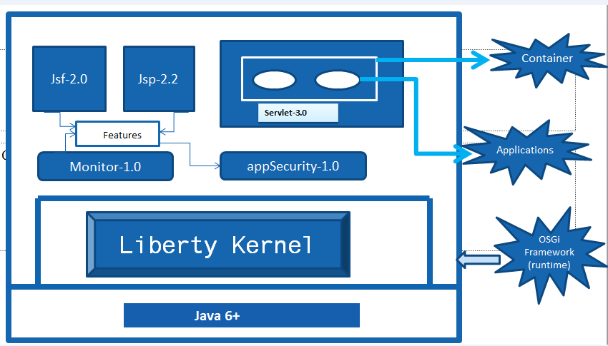
Liberty Profile
At its heart, the Liberty profile is a dynamic profile of WAS that enables the WAS server to provision only the features required by the application (or set of applications) deployed to the

Slide 6
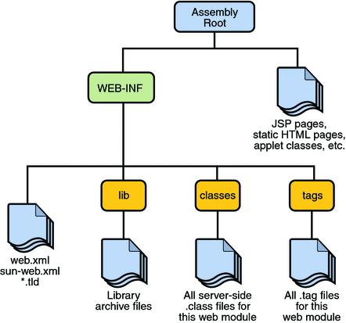
WAR Package
In software engineering, a WAR file (or Web application ARchive^{[1]}) is a JAR file used to distribute a collection of JavaServer Pages, Java Servlets, Java classes, XMLfiles, tag libraries, static web pages (HTML and related files) and other resources that together constitute a web application.

Slide 7
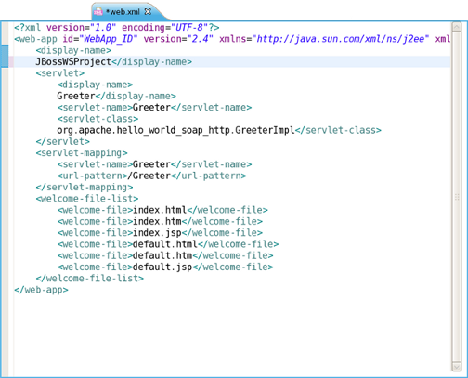
web.xml

Slide 8
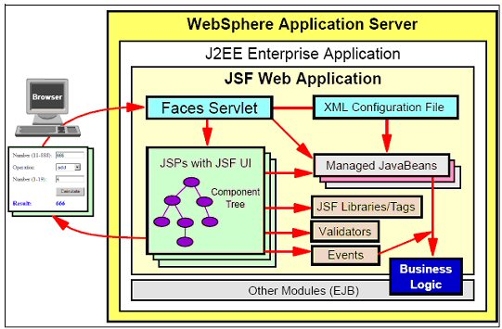
JSF – Java Server Faces

Slide 9
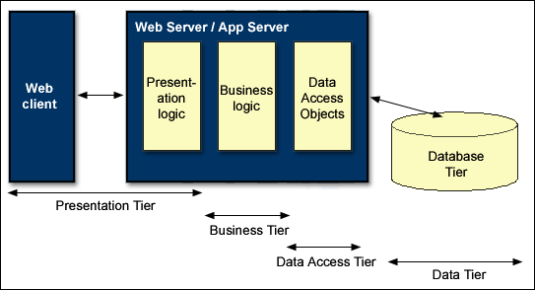
JSF – Java Server Faces

Slide 10
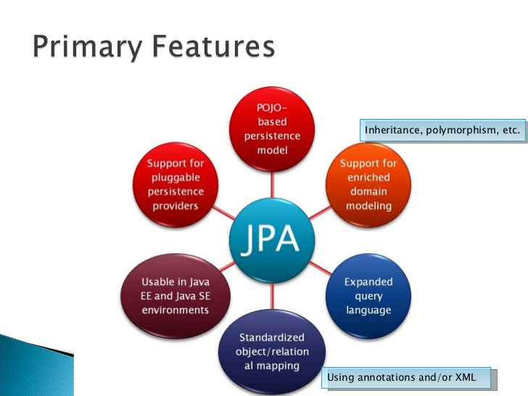
JPA – Java Persistence API
The Java Persistence API (JPA) is a Java specification for accessing, persisting, and managing data between Java objects / classes and a relational database. JPAwas defined as part of the EJB 3.0 specification as a replacement for the EJB 2 CMP Entity Beans specification.

Slide 11
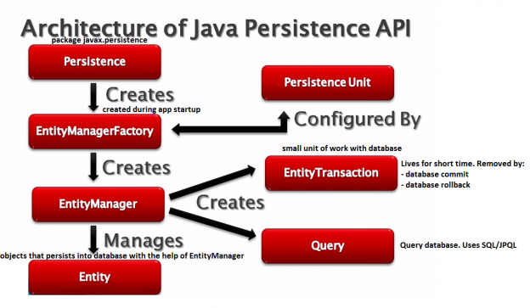
JPA – Java Persistence API

Slide 12
EJB – Enterprise Java Beans
The EJB specification details how an application server provides the following responsibilities:
Transaction processing
Integration with the persistence services offered by the Java Persistence API (JPA)
Concurrency control
Event-driven programming using Java Message Service and Java EE Connector Architecture
Asynchronous method invocation
Job scheduling
Naming and directory services (JNDI)
Interprocess Communication using RMI-IIOP and Web services
Security (JCE and JAAS)
Deployment of software components in an application server

Slide 13
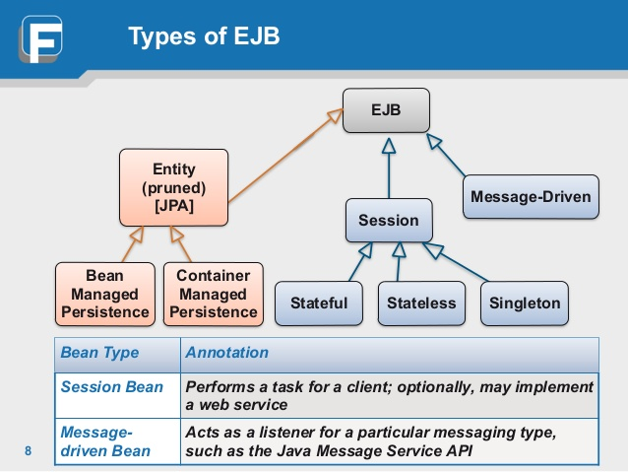
EJB – Enterprise Java Beans

Slide 14
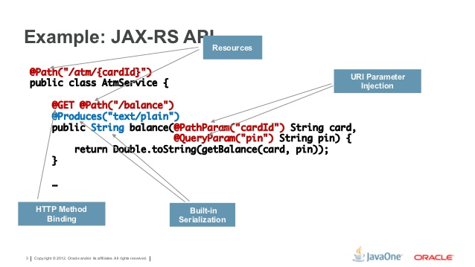
JAX-RS – JAX-RS – Java API for RESTful Web Services
JAX-RS: Java API for RESTful Web Services (JAX-RS) is a Java programming language API spec that provides support in creating web services according to the Representational State Transfer (REST) architectural pattern.

Slide 15
JAX-RS – Java API for RESTful Web Services

